Slide 1
Password Manager
SEGURIDAD EN EL DISEÑO DEL SOFTWARE - PRÁCTICA 2018/2019

Slide 2
Main Goals
Client – Server Architecture
User – Password authentification scheme
Secure network data management communication via TLS/HTTPS protocols
AES cipher (App/DB level)

Slide 3
Challenges
Client cipher, not dependency combined with server
Random Password Gen (through sized and defined chars)
Outcoming data structs (not only passwords and mails, also numbers, notes and cards)
***Graphic interface

Slide 4
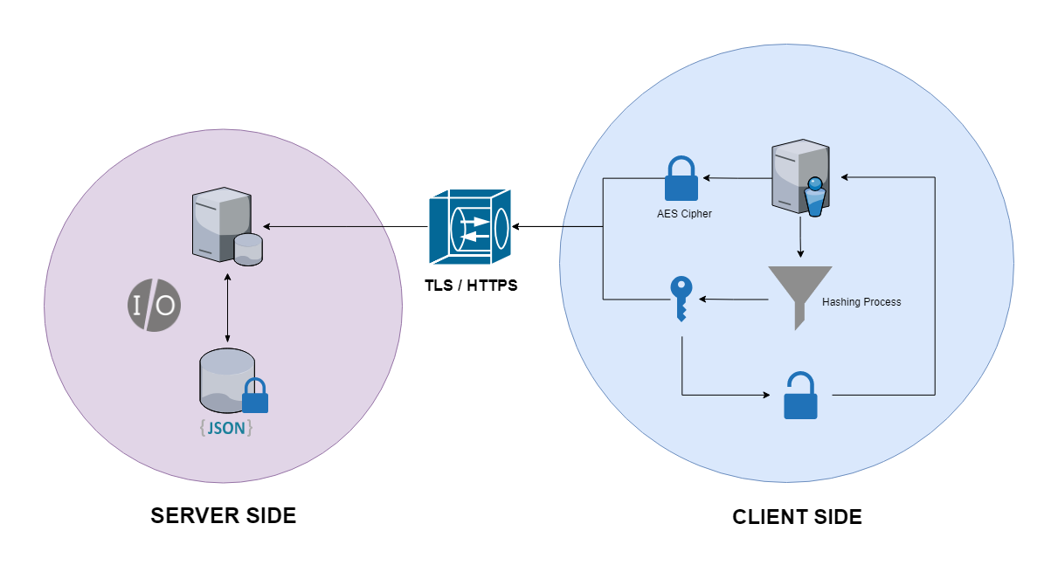
Implementation

Slide 5
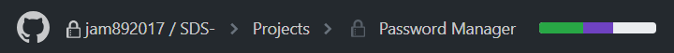

Development Status
KANBAN Dashboard

